Slide 1

Basic Details of the Team and Problem Statement
Mobile Computing With Android
Project Synopsis & Report
Project Title: Moody food recipes
Application Domain: Food recipes Created by: Vishwa Shah

Slide 2
Idea Approach Details
Technologies used :
1. Java : Used as the primary programming language to handle game logic, user interactions, and activity lifecycle in Android. Java is well-supported in Android development and perfect for beginners building mobile apps.
2. Android SDK (Framework): Provides the core tools and libraries needed to build Android apps. It supports activity management, UI elements, and system interactions.
3. XML (User Interface Design): Used to define the layout and visual structure of the app — including buttons, grid layout, text views, and overall app styling.
4. Android Studio (IDE): The main development environment used to write, compile, test, and debug the app. It offers an emulator for testing and tools for layout preview, resource management, and performance checks.
About Application:
This is a simple yet creative Android application that turns everyday moods into quick and comforting vegetarian meal ideas. By combining intuitive design with practical features, the app makes cooking more enjoyable and less stressful. This project demonstrates effective use of core Android components and highlights how even basic tools can be used to solve real-life problems in a fun, user-friendly way.

Slide 3
Idea Approach Details
Flowchart:
Start →
App Opens →
User selects mood →
Clicks “Show Recipe” or “Show Detailed Recipe” →
Recipe is displayed →
User exits or selects new mood
Use cases:
Quick decision-making for meal ideas
No login or data input required — instant use
Enhances user experience through personalization
Minimal design for quick recipe access
Great for students, beginners, or lazy day cooks

Slide 4
XML CODE:
<?xml version="1.0" encoding="utf-8"?><
RelativeLayout xmlns:android="http://schemas.android.com/apk/res/android" android:layout_width="match_parent" android:layout_height="match_parent">
<Spinner android:id="@+id/vibeSpinner" android:layout_width="wrap_content" android:layout_height="wrap_content" android:layout_centerHorizontal="true" android:layout_marginTop="50dp"/>
<Button android:id="@+id/showRecipeButton" android:layout_width="wrap_content" android:layout_height="wrap_content" android:text="Show Recipe" android:layout_below="@id/vibeSpinner" android:layout_centerHorizontal="true" android:layout_marginTop="20dp"/>
<Button android:id="@+id/viewRecipeButton" android:layout_width="wrap_content" android:layout_height="wrap_content" android:text="View Recipe" android:layout_below="@id/showRecipeButton" android:layout_centerHorizontal="true" android:layout_marginTop="20dp"/>
<TextView android:id="@+id/recipeText" android:layout_width="wrap_content" android:layout_height="wrap_content" android:text="Recipe will appear here" android:layout_below="@id/viewRecipeButton" android:layout_centerHorizontal="true" android:layout_marginTop="30dp" android:textSize="18sp" android:textColor="#333"/> <TextView android:id="@+id/detailedRecipeText" android:layout_width="wrap_content" android:layout_height="wrap_content" android:text="" android:layout_below="@id/recipeText" android:layout_centerHorizontal="true" android:layout_marginTop="20dp" android:textSize="16sp" android:textColor="#555" android:visibility="gone"/>
</RelativeLayout>

Slide 5
Java code:
package com.example.vibecheck;
import android.os.Bundle;
import android.view.View;
import android.widget.ArrayAdapter;
import android.widget.Button;
import android.widget.Spinner;
import android.widget.TextView;
import androidx.appcompat.app.AppCompatActivity;
public class MainActivity extends AppCompatActivity {
Spinner vibeSpinner;
Button showRecipeButton, viewRecipeButton;
TextView recipeText, detailedRecipeText;
String[] vibes = {"Cozy Rainy Day", "Hungover", "Lazy Sunday", "Feeling Healthy", "Chill
Vibes"};
String[] recipes = {
"Mushroom Soup & Bread", // Cozy Rainy Day

Slide 6
"Veggie Tacos", // Hungover
"Avocado Toast & Roasted Veggies", // Lazy Sunday
"Zucchini Noodles", // Feeling Healthy
"Hot Chocolate" // Chill Vibes};
// Detailed recipes for each dish
String[] detailedRecipes = {"Mushroom Soup & Bread:\n1. Sauté onions and garlic in a pot.\n2. Add chopped
mushrooms and cook until soft.\n3. Add vegetable broth, salt, and pepper.\n4. Simmer for 15
minutes, blend to desired consistency.\n5. Serve with crusty bread.",
"Veggie Tacos:\n1. Sauté your favorite veggies like bell peppers, onions, and
zucchini.\n2. Heat tortillas.\n3. Fill tortillas with sautéed veggies.\n4. Add your favorite toppings
like lettuce, salsa, and cheese.",
"Avocado Toast & Roasted Veggies:\n1. Roast veggies like sweet potatoes and
carrots.\n2. Toast your bread.\n3. Smash avocado and spread on toast.\n4. Top with roasted
veggies and season with salt and pepper.",
"Zucchini Noodles:\n1. Use a spiralizer to create zucchini noodles.\n2. Sauté zucchini
noodles with olive oil, garlic, and herbs.\n3. Serve with your favorite sauce (like marinara or
pesto).",
"Hot Chocolate:\n1. Heat milk in a pot.\n2. Stir in cocoa powder, sugar, and a pinch of
salt.\n3. Bring to a simmer while stirring.\n4. Top with whipped cream or marshmallows." };
@Override
protected void onCreate(Bundle savedInstanceState) {
super.onCreate(savedInstanceState);
setContentView(R.layout.activity_main);
vibeSpinner = findViewById(R.id.vibeSpinner);

Slide 7
showRecipeButton = findViewById(R.id.showRecipeButton);
viewRecipeButton = findViewById(R.id.viewRecipeButton);
recipeText = findViewById(R.id.recipeText);
detailedRecipeText = findViewById(R.id.detailedRecipeText);
// Set up spinner adapter for vibes
ArrayAdapter<String> vibeAdapter = new ArrayAdapter<>(this,
android.R.layout.simple_spinner_item, vibes);
vibeAdapter.setDropDownViewResource(android.R.layout.simple_spinner_dropdown_item);
vibeSpinner.setAdapter(vibeAdapter);
// Set button click listener to show recipe based on selected vibe
showRecipeButton.setOnClickListener(new View.OnClickListener() {
@Override
public void onClick(View v) {
int selectedVibePosition = vibeSpinner.getSelectedItemPosition();
String selectedRecipe = recipes[selectedVibePosition];
recipeText.setText("Recipe for " + vibes[selectedVibePosition] + ":\n" +
selectedRecipe);
detailedRecipeText.setVisibility(View.GONE); // Hide detailed recipe initially }
});// View the detailed recipe when clicked
viewRecipeButton.setOnClickListener(new View.OnClickListener() {
@Override
public void onClick(View v) {
int selectedVibePosition = vibeSpinner.getSelectedItemPosition();
detailedRecipeText.setText(detailedRecipes[selectedVibePosition]);
detailedRecipeText.setVisibility(View.VISIBLE); // Show detailed recipe
} });
}
}

Slide 8
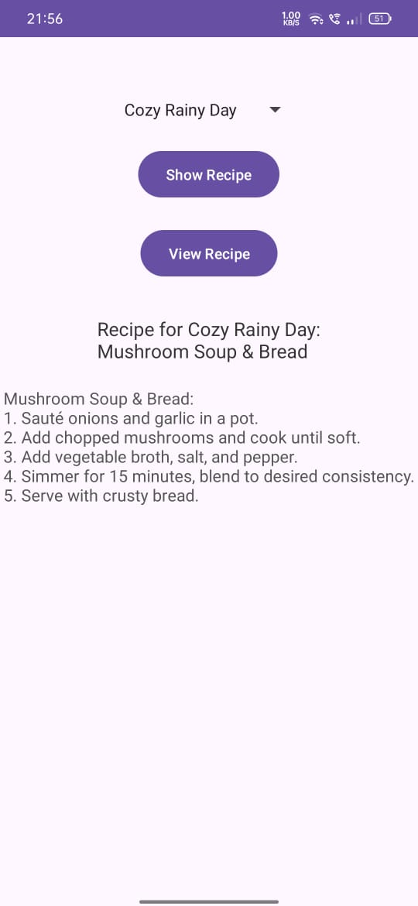
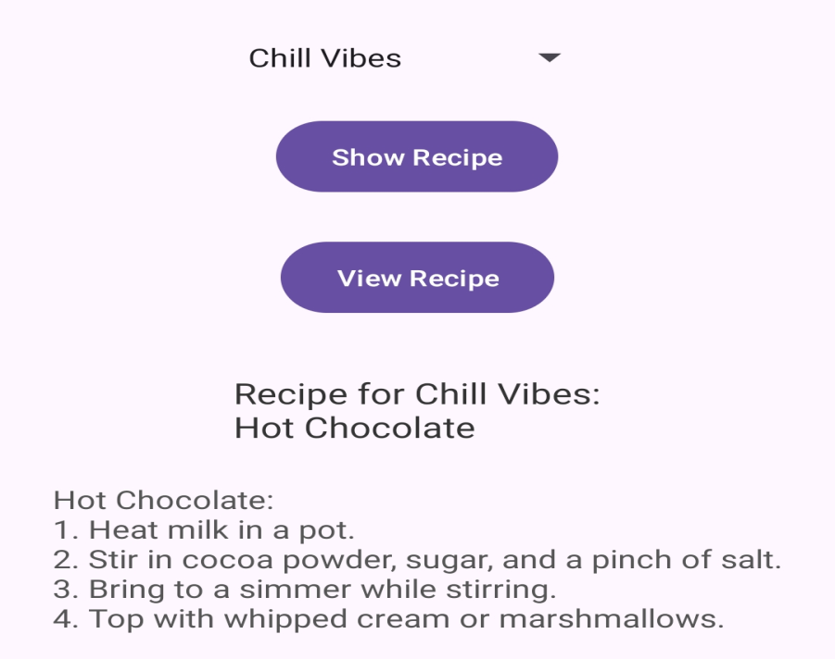
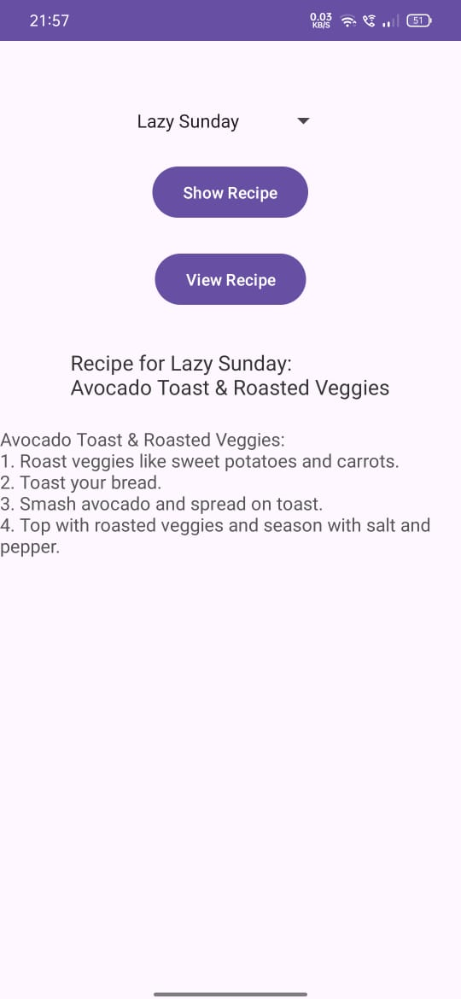
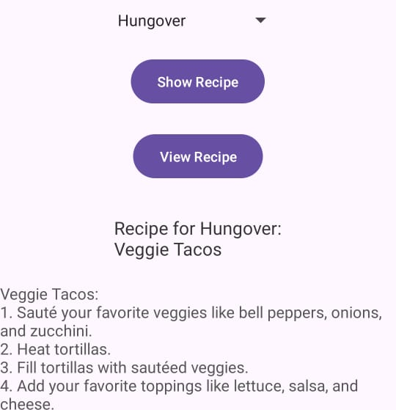
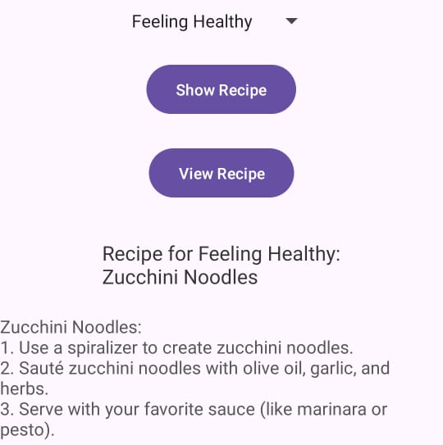

Slide 9
Conclusion & Future Plans
Key Takeaways
Learned to build a functional Android app using Java
Used UI components like Spinner, Button, and TextView effectively
Practiced organizing data (moods and recipes) using arrays
Future Enhancements
Add images for each recipe to make the app more visual
Add a feature to share recipes on social media
Support multiple languages or voice assistant integration

